Slide 1





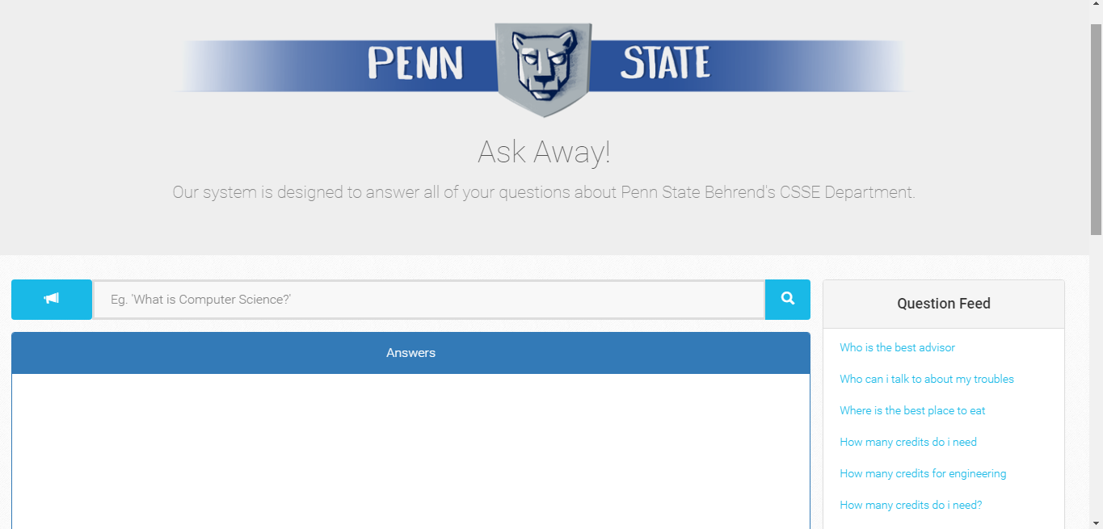

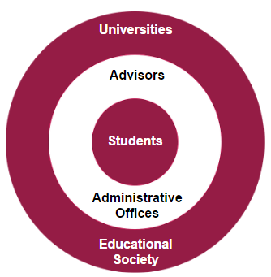


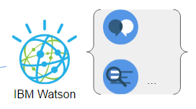

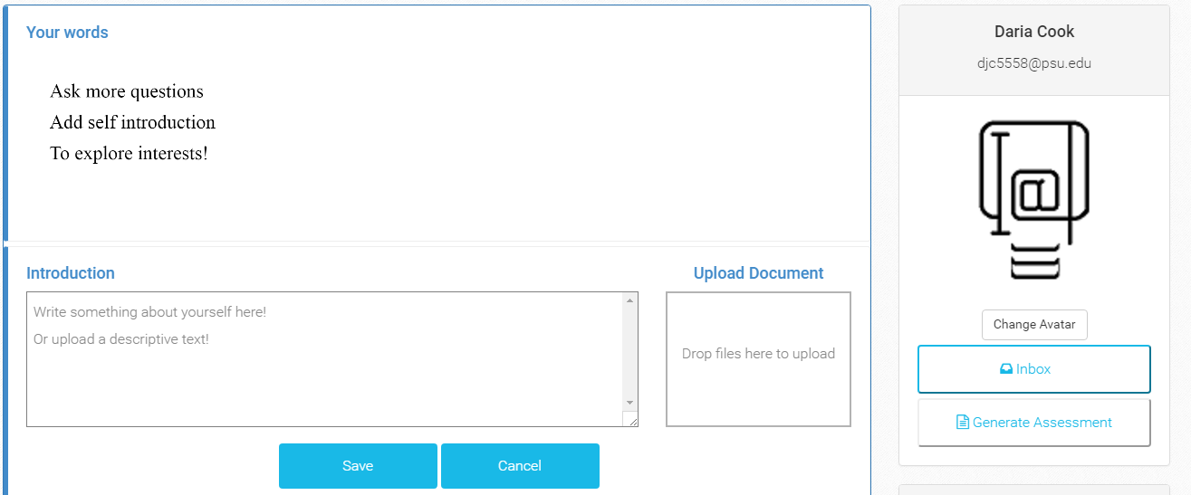

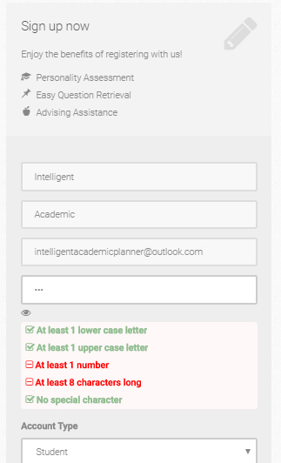





Intelligent Academic Planner
2017 Richard J. Fasenmyer Engineering Design Conference
Introduction
Author & Abstract
Practical Application
IBM Watson’s services, which are provided by BlueMix APIs, are utilized in our project to answer questions in natural language format, to conduct textual analysis and then output a numerical scale of performance based on the analysis. We used several Watson services such as Conversation, Natural Language Understanding, Document Conversion, Retrieve and Rank, and Personality Insights in the backend, and created a user friendly frontend interface for the application using Bootstrap. We built this system to assist with the student advising process. Students can use this tool to be advised on which fields would coincide with their interests and talents. They can also ask this intelligent academic robot questions and get assistance in academic information.
Student Team: Daria Cook, Krystal Elliott, and Xiaoyu Zhou
Faculty Adviser: Dr. Meng Su
Industry Mentor: Dr. Adriano Cavalcanti
Sponsored By: Penn State Behrend
The system can be used by the faculty and students of Penn State Behrend to obtain answers related to questions commonly asked about the CSSE program and to assist in student advisement.
Students can use the application to ask the system questions about their major and the college. This can educate students about the different programs within the CSSE department and help them make a decision as to which major they should pursue.
The system keeps track of questions asked and generates an estimation of a person’s personality based on the questions asked. In addition, the person can input descriptions or documents to provide further analysis. This can be used to tell the student, or the advisor, what they prioritize.
Advisors can use the application to request assessments from students, which will provide a list of questions a student has asked the system, in addition to an assessment of the student’s personality and interests. Using this information, advisors are able to help them make decisions about where they want to go in the future and recommend courses to lead student’s along their desired path.
Abstract
The IBM Watson uses “natural language processing and machine learning” to reveal insights from large amounts of unstructured data. We will use Watson to create a structured analysis of possible academic careers related to the CSSE majors at Penn State Behrend.
We seek to enable students to ask questions relating to these majors and to provide valuable feedback, promoting better decision making about academic and professional careers. Our tools will also assist advisors in preparing relevant and unique advice to each student seeking their guidance.
Objectives
Results
The objective of this project is to use the IBM Watson cognitive services to create a tool that can provide consultation to students, who are interested in computing majors for their academic queries, while factoring this in assessment of their personality. The tool should be able to create an assessment based upon the student’s self description and other documents they submit to the system (for example, a transcript), and the types of questions the user asks.
The system allows users to access several different pages: Ask Question, Login/Register, Profile, and Inbox.
On the Login/Register page, users can register to gain access to the profile and personality functionality. Registration requires a first name, last name, email, and password. A user-friendly notification displays when creating a password that explains the password requirements and whether they have been met.
Users can also login either locally or using some well-known services such as Google, Facebook, and LinkedIn. If a user forgets their password, they can choose to have it reset which will send them an email with reset instructions.
On the Ask Question page, users input questions to ask the system and receive responses. Users can also provide feedback on the answers for the question and favorite any questions, storing them on their profile page.
Third-Party Software
Figure 2 (Above): Ask Question Page
Figure 3 (Below): Profile Page
Figure 1: Broader Impacts
References
Locally, we hope to impact those interested in Penn State Behrend’s CSSE programs, by offering guidance concerning the decisions pertaining to their future career. On an organizational level, we believe that our tool could be scaled to assist other programs in universities or institutes providing counsel, such as a juvenile detention center, where perhaps a user is not yet aware of the opportunities that exist for them. Globally, we hope to further the field of knowledge that combines inquiries with a user’s personal information for a custom tailored answer retrieval system.
I. B. M. What is IBM Watson? http://www.ibm.com/watson/what-is-watson.html (accessed Oct 5, 2016).
Watson Developer Cloud https://www.ibm.com/watson/developercloud/retrieve-rank.html (accessed Oct 5, 2016).
3 Types of Survey Research, When to Use Them, and How they Can Benefit Your Organization! https://fluidsurveys.com/university/3-types-survey-research-use-can-benefit-organization/ (accessed Oct 21, 2016).
On the Profile page, users can input descriptions about themselves or their academics or upload documents for the system to use. Once enough information is gathered, the system will display personality information about the user. Users can also find their asked questions and favorited questions here. Lastly, you can generate an assessment to send to an advisor using the information on the profile information.
The inbox page will store any messages from advisors requesting assessments.
Figure 4: Register part of Login/Register Page

